Slide 1
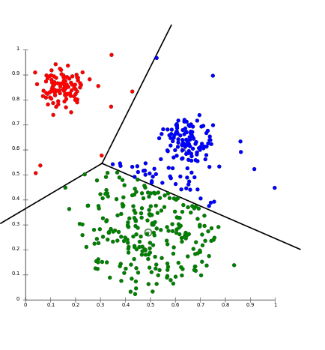
K-means clustering – Project proposal
Marzia Matejcek, Leonie Gerling,
Annika Wehrle, Ege Bayraktar
https://aws.amazon.com/de/blogs/machine-learning/k-means-clustering-with-amazon-sagemaker/
<Foliennummer>

Slide 2
K-means
K-means ++
Mini-Batch
Task:
compare your implementation with the sklearn implementation with respect to quality and speed.

Slide 3
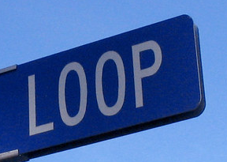
k-means
On PCA plots
Random number «k» and placement of centroids
Find minimal Euclidian distance between object and centroid
Assign the object to the closest centroid
Re-arrangement of the centroids, minimizing mean distance to its assigned objects
Until: Convergance!
Iterations

Slide 4
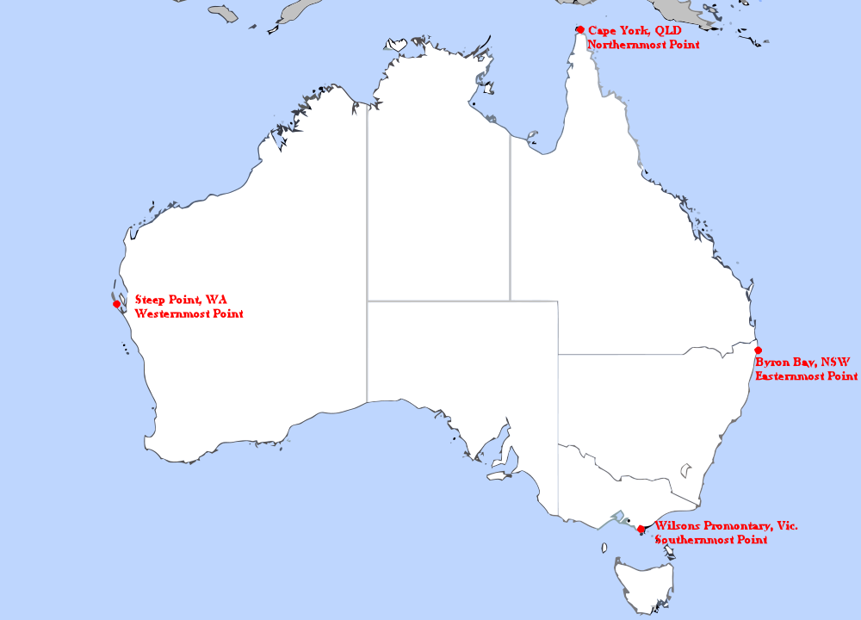
k-means ++
Randomly chosen object as centroid
Calculate the Euclidian distance D(x) to every other object
Position the next centroid at the furthermost object
Define k-centroids and repeat the normal k-means algorithm
Reduces Iterations!
Doubles the speed of k-means!

Slide 5
Mini-batch k-means
Centroids placed into data with a decided amount of batch-growth
Centroid assignment per-sample.
Arrange centroid according to the minimal euclidian median of first sample
than the median distance of the first and second sample…

Slide 6
Data
Gene expression of peripheral blood mononuclear cells (PBMCs) from a healthy donor
PBMCs = peripheral blood cells with a round nucleus e. g. T-cells, B-cells, monocytes
Method: UMI marked mRNA (unique molecular identifier) → ratio of molecules in cells is preserved
2700 cells, 32738 genes (→ dimension reduction, nonlinear)

Slide 7
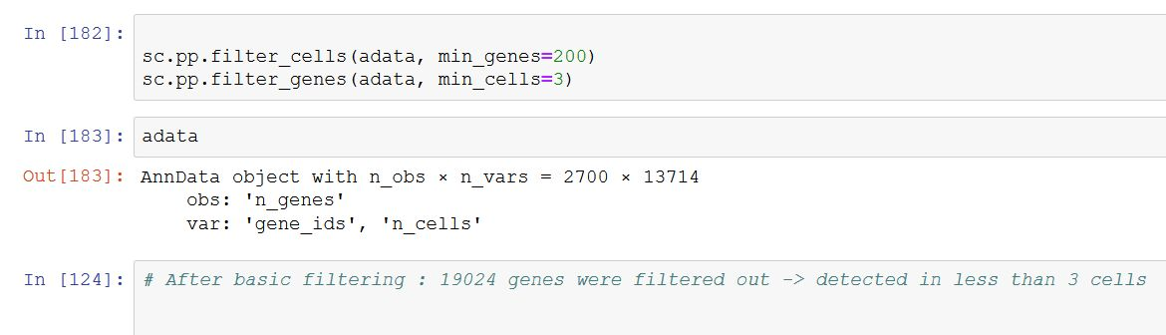
Data / reduction of dimension
Data cleanup: eliminate genes that are expressed in less than 3 cells
PCA (Principal Component Reduction) or t-SNE or UMAP to reduce number of dimension without losing to much information

Slide 8
Cell Type | Markers
Naive CD4+ T – cell | IL7R, CCR7
Memory – T - cell CD4+ | IL7R, S100A4
Natural killer cell | GNLY, NKG7
B – Cell | MS4A1
CD8+ T – cell | CD8A
FCGR3A+ monocyte | FCGR3A, MS4A7
CD14+ monocyte | CD14, LYZ
Dendritic cell | FCER1A, CST3
Platelet | PPBP
lymphocytes
monocytes
https://satijalab.org/seurat/v3.0/pbmc3k_tutorial.html
<Foliennummer>

Slide 9
Project schedule
K-means algorithm
-> comparison with sklearn implementation
1. week
2. week
Python, packages, basic knowledge
<Foliennummer>

Slide 10
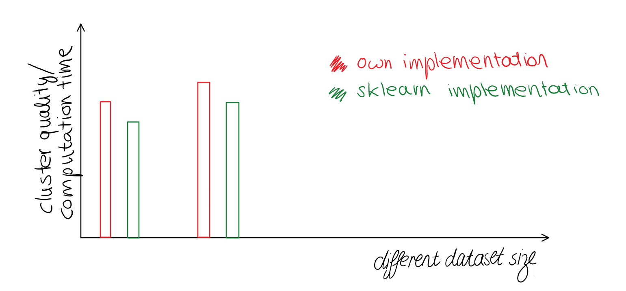
Tabels for different datasets with various sizes:
Multiple plots for visualization:
e.g. :
k | Average sum of squared distance Algorithm sklearn implementation |  | Minimum - “ - |  | Average T (computation time)
i.e. 10
25
50
<Foliennummer>

Slide 11
Project schedule
K-means algorithm
-> comparison with sklearn implementation
Visualization of results,
Answer our questions
K-means ++ algorithm
Dataset processing: PCA..
1. week
3. week
5. week
7. week
2. week
4. week
6. week
8. week
Python, packages, basic knowledge
Mini-batch algorithm
Comparison of methods -> some cool plots
cluster the dataset
Comparison of algorithms
<Foliennummer>
Notes:
<Foliennummer>

Slide 12
A few questions
Which algorithm for which type/ size of data?
Limits of several algorithms?
What could we predict if we cluster the data?
<Foliennummer>

Slide 13
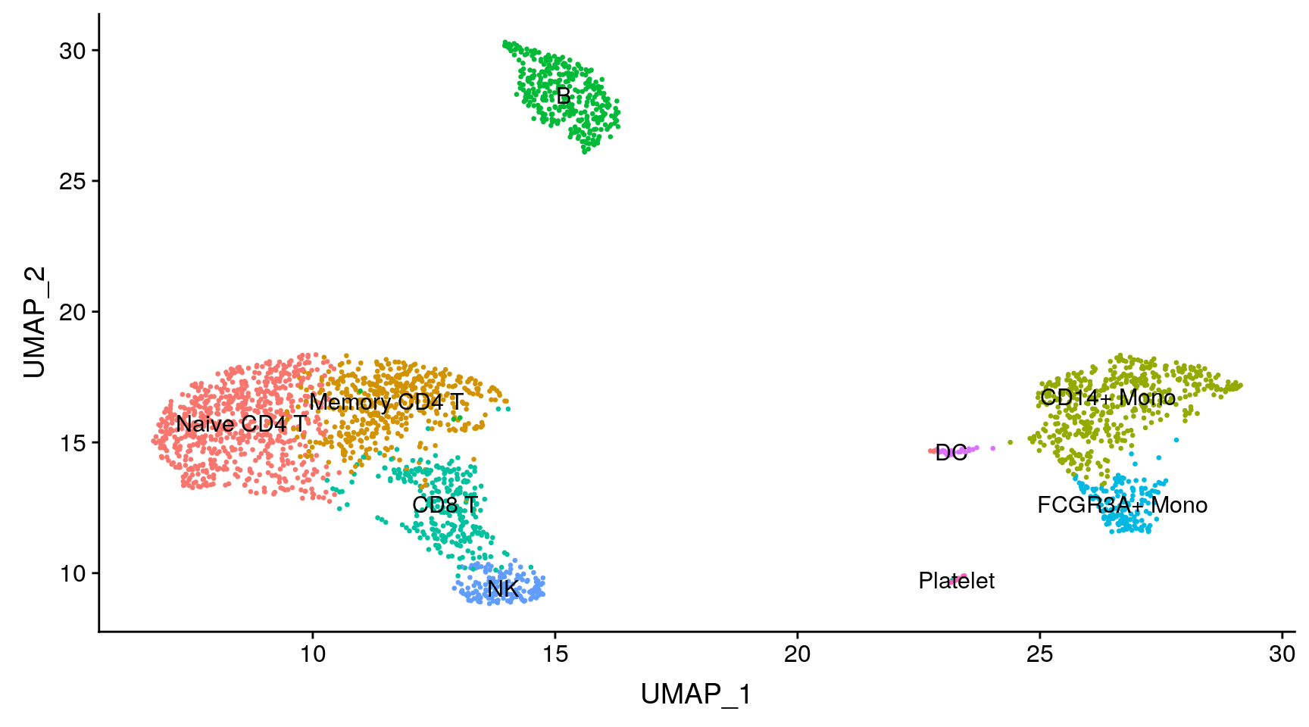
Goal
https://satijalab.org/seurat/v3.0/pbmc3k_tutorial.html
<Foliennummer>

Slide 14
Questions
Can we find clusters that show only one type of cell?
→ find marker genes
Which genes are expressed the most by which cell type?
How homogenous/heterogenous is the population?
Can we use the cluster pattern (of other patients) to predict/diagnose diseases?
<Foliennummer>

